Slide 1
Exploratory analysis for CompanyName's sales data

Slide 2
Data overview
Dates are from January 1st 2020 to December 26th 2023, but last nonzero entry dates to December 27 2022
17439 of all observations, 13229 after removing empty 2023 year
Number of zeros in volume ordered: 4810
Most commonly zeros are present for ProductName, more each year
There are 50 negative values in orders, mostly for ProductName and from Grocer 1, more each year

Slide 3
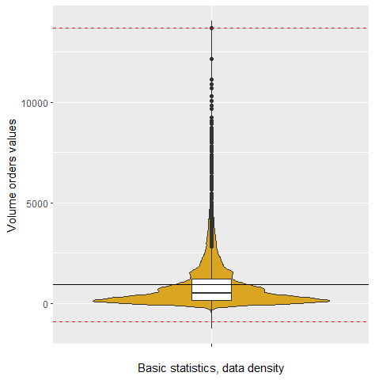
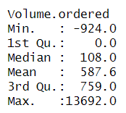
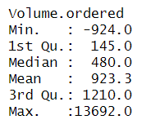
Satistical overview
Summary for all data (w/o 2023)
Summary for data without zeros

Slide 4
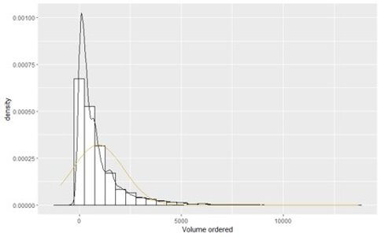
Data is not normally distributed
Definitely not normal distribution, even after removing all zeros (visible in plots, Shapiro-Wilk and KS tests are invalid when there is over 5000 observations)

Slide 5
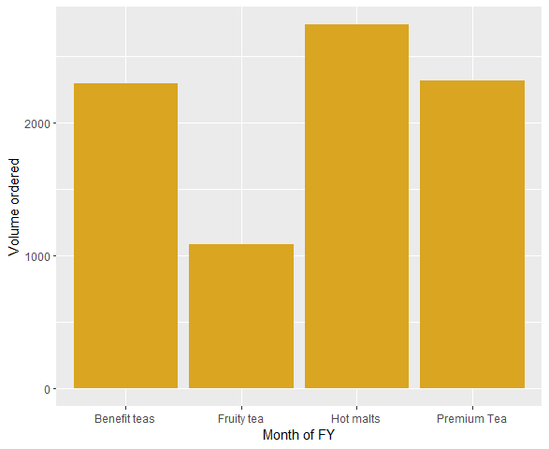
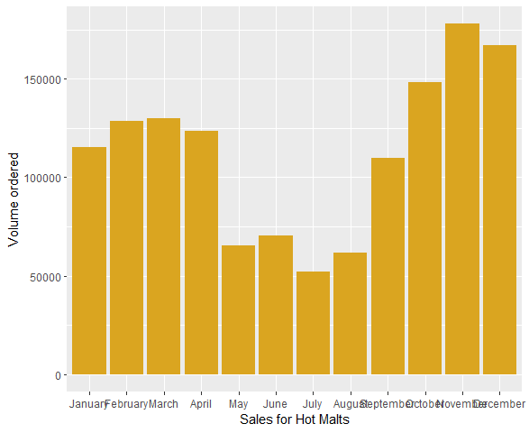
Possible tendencies
There is no clearly visible trend in sales, they may appear to be higher in winter, but it is not apparent when analizing each year separately
Most popular products are ProductName, they appear to be ordered in larger amounts in winter season, for other products it is not clear

Slide 6
Doubts and questions
What do negative values in orders mean? ​
How are fiscal years defined within your company?​
Is this analysis primarily focused on safety stock planning, or do we also need to consider transport consolidation? ​
Would you like us to concentrate on a specific planning term, such as the mid-term (e.g., 3 months) or long-term (e.g., 18 months)? Alternatively, are there any other timeframes or specific periods that we should consider for the planning process?​
What exactly do we want to predict: sales over time for each product, or do we also need to analyze sales for each grocer?

